Slide 1



Strategies to Measure and Control your Contingent Labor Program Costs
Sponsored and presented by:
25 September 2019
Notes:
For procurement professionals, cost savings and cost avoidance areas are always a top priority.
And although HR departments are seeing an increased role in managing contingent labour programmes, at most companies, the programme is still owned primarily by procurement.
Regardless of programme ownership, many aspects of managing non-employee labour can impact programme spend, and programme managers face common finance-related challenges, such as
· Maverick programme spend
· Budget forecasting inabilities
· Insufficient budget visibility.
A vendor management system (VMS) can help measure programme costs, but to really gain control, leaders and managers need to know what to measure in order to make cost-conscious, data-driven decisions.
This webinar will provide you the strategies to analyse your spend allocation to determine smart, practical ways to gain greater control over contingent labour programme costs overall.

Slide 2

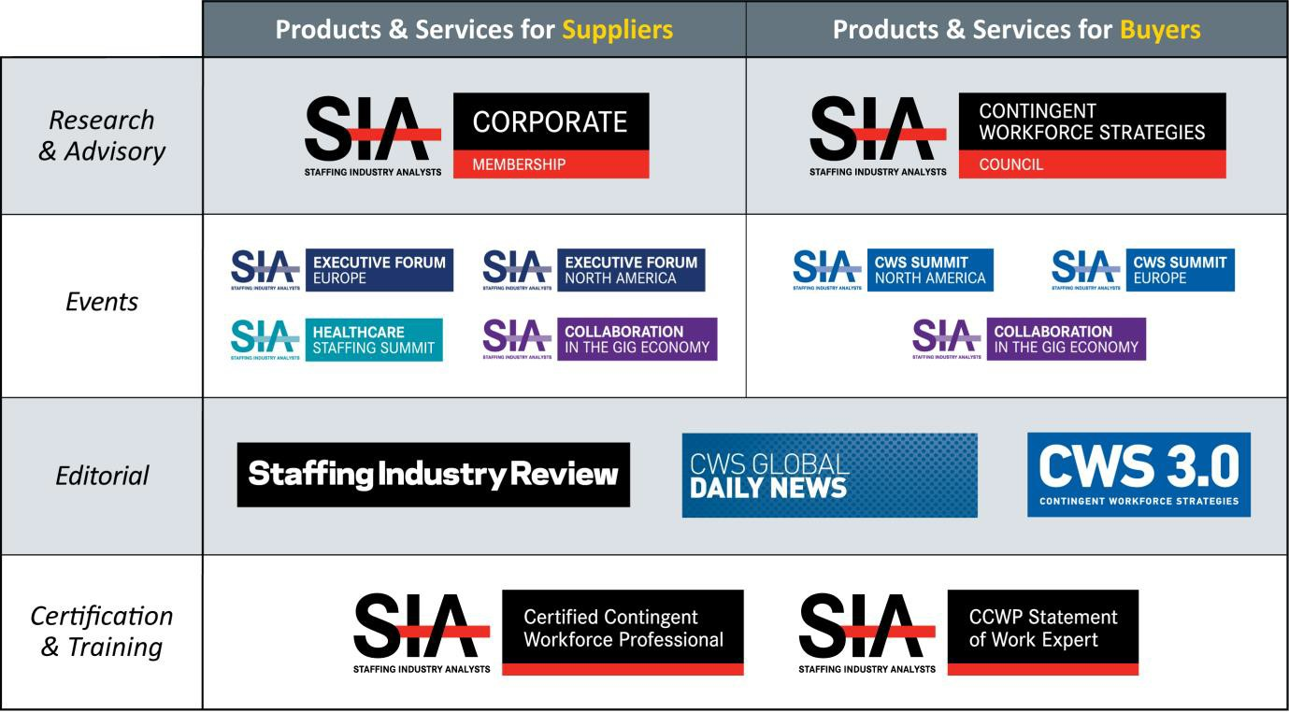
Staffing Industry Analysts Product Overview
SIA | Staffing Industry Analysts Contingent Workforce Strategies Council Webinar
Notes:
SIA is the global advisor for staffing and workforce solutions. We offer a range of events, research and editorial products for staffing firms and buyers focused specifically on staffing and solutions. Our members enjoy access to our objective research and analysts, event discounts, editorial publications and advisory services. SIA’s mission is to inform, connect and elevate the staffing and workforce solutions ecosystem. Upcoming events include:
CCWP & SOW CERTIFICATION |www.staffingindustry.com/certification
Healthcare Staffing Summit November 6-8, 2019 | Red Rock Resort, Las Vegas, NV www.healthcarestaffingsummit.com
Executive Forum Europe November 19-20, 2019 | Leonardo Royal Hotel London St. Pauls, London www.siexecutiveforum.eu
Executive Forum North America March 9-12, 2020 | The Fontainebleau Hotel, Miami Beach, FL www.siexecutiveforum.com
CWS Summit Europe April 21-22, 2020 | Royal Lancaster Hotel, London www.cwssummitwe.eu

Slide 3

Audio
Listen through your computer by turning on your speakers after you log into the event. Sound will be coming through the audio icon (below left).
DO NOT close this audio broadcast box.
Use the sound bar on the audio broadcast box to adjust the volume.
Need assistance? Please let us know in the
Q&A section.
SIA | Staffing Industry Analysts Contingent Workforce Strategies Council Webinar

Slide 4
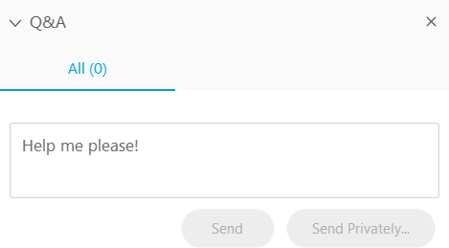
Questions?
Questions may be submitted at any time.
Click on the Question Mark section
to open the Q&A window.
Type your question into the small dialog box and click the Send Button.
The presentation will be shared with registrants.
SIA | Staffing Industry Analysts Contingent Workforce Strategies Council Webinar

Slide 5


Peter Reagan, CCWP & SOW Management Expert
Senior Director of Contingent Workforce Strategies & Research, SIA
Moderator:
Cindy Chunn,
Senior Program Manager, VectorVMS
Sponsored and presented by:
Speaker:
25 September 2019
Notes:
Cindy Chunn, Sr. Program Manager, VectorVMS,cindy.chunn@vectorvms.com Cindy’s bio:
Cindy Chunn brings over 20 years’ experience to the VectorVMS Strategic Services team. Cindy serves as a strategic partner to our clients, providing implementation support for our VMS technology and consultation services for contingent workforce program management.
In her five years with VectorVMS, Cindy has successfully led strategic business objectives, process improvements, and operational excellence for large and mid-market clients.
Prior to VectorVMS, Cindy spent six years with Manpower as a regional director, overseeing multiple branches and large contingent workforce programs. She also served as a government solutions executive, blending public and private talent solutions for clients in the public sector.

Slide 6
Strategies to Measure and Control your Contingent Labor Program Costs
Cindy Chunn
Senior Program Manager
VectorVMS

Slide 7

Agenda
Cost challenges of managing contingent workforce labor programs
8 key metrics that can help control your contingent labor costs
Getting started

Slide 8

What is contingent labor?
A contingent workforce is a labor pool whose members are hired by an organization on an on-demand basis. A contingent workforce consists of consultants, independent contractors and freelancers and other forms of temporary workers, who are not on the company's payroll because they are not full-time employees of the organization.

Slide 9

Challenges of Contingent Labor Programs
Ownership: Who owns the program and who is responsible for cost containment?
Cost challenges:
How do I control maverick spend?
How do I forecast budget
How do I get visibility to the budget?
Notes:
Within a Contingent Labor Program, there are many advantages none more important than cost savings and cost avoidance. While we are seeing an increase in Human Resources playing a part in Contingent Labor programs, they are partnered with Procurement and both are tasked with cost containment.
Regardless of program ownership, many aspects of managing “non-employee labor” can impact program spend, leaving program managers to face common finance-related challenges such as:
Controlling Maverick Spend
Budget forecasting inability
Insufficient budget visibility

Slide 10
Who owns program management of your contingent or “non-employee” workforce in your organization?
Procurement
Human Resources/Talent Management
Both
None of the above
Polling Question

Slide 11
8 Metrics Used to Analyze and Control Costs
Review and Standardize
Rates
Negotiate Discounts
Analyze Overtime Usage
Manager Conversion Fee
Control
Costs
Develop Consistent
Bill Rates
Track and Address
Trends in Replacements
Consolidate Budget
Tracking
Forecast Your Spend
Notes:
A vendor management system (VMS) can help measure program costs, but to really gain control, leaders and managers need to know what to measure in order to make cost-conscious, data-driven decisions.
There are many ways to look at controlling contingent labor cost. Today, we will examine 8 metrics that will assist in analyzing your spend allocation to determine smart, practical ways to gain greater control over contingent labor program costs.

Slide 12
Who owns program management of your contingent or “non-employee” workforce in your organization?
Procurement
Human Resources/Talent Management
Both
None of the above
Polling Results

Slide 13

#1 - Review and Standardize Vendor Rates
Problem: Inconsistent rates across vendors can result in overpaying for labor
Solution:
Use VMS data to analyze vendor rates across your program
Analyze rates by job title and location
Standardize “mark-up” or “not to exceed” rates with each vendor
Tip: Your vendors with the best rates could be rewarded with a “top vendor tier”, allowing them to receive the requisitions before the rest of the vendor pool, gaining better fulfillment opportunities and market share.
Notes:
Perhaps the most problematic trend currently facing contingent labor programs is a lack of consistent rates across vendors. Setting rates by vendor isn’t just inefficient—it can easily result in your organization overpaying for labor.
Utilize your VMS data to analyze vendor rates across your program. Look for the differences in vendor rates that share the same job title and location and try standardizing each vendor to a standard mark-up or not to exceed rate. This is a simple first step toward driving down your overall program costs.

Slide 14
Polling Question
If you utilize Vendor Tiers to standardize vendor rates, what is it based on
Price
Quality of service
Ability to service locations
Diversity affiliation
Other

Slide 15

#2 - Analyze Overtime Usage
Problem: Overtime pay can become costly as it multiplies
Solution:
Track overtime pay in VMS or time-keeping system
Analyze trends across departments, managers, projects and time periods
Data provides insight for future work allocations
Tip: When you are negotiating rates with your vendors be sure to understand how the percent of vendor markup will be applied. You may be able to negotiate a markup reduction on overtime hours.
Notes:
Compliance with overtime pay policies—paying workers time and a half—can become costly as it multiplies. Tracking vendor overtime in your VMS or third party time-keeping system will enable you to identify trends in overtime usage.
Use the VMS data to look for trends in overtime use across departments, managers, projects and time periods. This data will allow your business unit to make educated decisions about future work allocations.

Slide 16
Polling Results
If you utilize Vendor Tiers to standardize vendor rates, what is it based on
Price
Quality of service
Ability to service locations
Diversity affiliation
Other

Slide 17

#3 - Develop Consistent Bill Rates
Problem: Inconsistent bill rates indicate uncontrolled spend and high program costs
Solution: Minimize cost disparities
Measure rate consistency across your organization and the market standard
Look for excessive fluctuation and adjust rate’s maximum range
Compare rates to market standard by location
Establish parameters around bill rates
Tip: Managed service providers (MSPs) and shared managed services partners can help you benchmark your rates against the industry standard.
Notes:
Your bill rates are perhaps the most direct and impactful measure of contingent program costs. To better understand bill rates across your program, start by measuring two key areas—rate consistency across your organization and the market standard.
Excessive fluctuation between bill rates by manager—especially those in the same department—may indicate uncontrolled spend and a need to adjust the rate’s maximum range.
To help minimize cost disparities, compare your rates to the market standard in your location. Benchmarked rate data along with normalized rates across managers will help establish parameters around your bill rates.

Slide 18
Polling Question
How are you tracking your Vendor bill rates today?
Individual Vendor
Labor Categories
Locations
None of the above

Slide 19

#4 - Consolidate Budget Tracking
Problem: No visibility into annual spend making it difficult to track budgets
Solution: Use VMS data to gain total visibility
Budget vs. actual spend
Up-to-date consumption
Analyze data in multiple views
  Department
  Location
  Financial Strings
Tip: If using a VMS to manage your contingent labor program, activate budget warnings to receive real-time alerts about the remaining budget percentage for your resources.
Notes:
Visibility of your organization’s contingent labor spend through VMS data is a tangible way to measure and control spend. The available data gives you total visibility to your budget vs actuals, tracking budget spend as well as up-to-date consumption. The VMS allows you to analyze this data in multiple views, such as:
Department
Location
Financial Strings
This level of transparency gives you deeper knowledge of and control over how your program spend is allocated.

Slide 20
Polling Results
How are you tracking your Vendor bill rates today?
Individual Vendor
Labor Categories
Locations
None of the above

Slide 21

#5 - Negotiate Discounts
Problem: No visibility in program spend across vendors making it difficult to prepare for negotiating discounts
Solution:
Use VMS data to gain visibility across vendor population
Common staffing agency discounts
  Tenure
  Volume
  Overtime
  FUTA/SUTA max
  Labor categories
Tip: While you want to save as much as possible, don’t tarnish supplier relationships by asking for too many discounts. Having the data should allow you to negotiate, keeping your strategic talent goals in mind.
Notes:
VMS data becomes invaluable in tracking and reviewing the allocation of program spend across your vendor population.
This will allow you to be prepared for conversations with your vendors when negotiating possible discounts.
Some of the common staffing agency discounts apply to the following:
Tenure
Volume
Overtime
FUTA/SUTA max
Labor Categories

Slide 22

#6 - Manage Conversion Fees
Problem: Converting workers from temporary to full time can incur additional fees
Solution: Use VMS data to
Track dates and costs of conversions to determine the most cost-effective time to convert a contractor
Use logic in your reporting engine to calculate the waiting period for securing the lowest fee.
Tip: Be sure to negotiate all conversion timelines/fees in your vendor MSA or ahead of candidate start date so you will know the full “Cost”
Notes:
As the labor market gets tighter, quality talent is becoming more difficult to source. So when you finally find the right candidate, you may be inclined to convert them quickly from temporary to full time. But this, as you know, incurs additional fees, which can get costly.
Here again, data can help. By tracking conversions and fees, you can determine the most cost-effective time to convert a contractor.
Track dates and associated costs of converting contingent workers. Use logic in your reporting engine to calculate the waiting period for securing the lowest fee.

Slide 23
Polling Question
Who negotiates your vendor rates and fees?
An MSP who runs your contingent workforce program
Internal by HR
Internal by procurement
All of the above
None of the above

Slide 24

#7 - Track and Address Trends in Replacements
Problem: Difficult to predict talent flight risks - making worker turnover one of the highest expenses in your program
Solution: Use VMS data to
Examine trends in unsuccessful engagements across vendors and managers
Adjust accordingly
Tip: VMs data will allow you to identify candidate’ s who may have left past assignment’s prematurely. The system will allow you to tag this candidate in a way that will alert future managers of the early departure to avoid additional turn.
Notes:
Worker turnover can be one of the highest expenses in your program. Not only do you lose hard dollars in ongoing recruiting efforts, you lose valuable time and incur indirect costs to source, train, and onboard a new candidate to take over an incomplete project.
To reduce talent flight risk, look for trends in unsuccessful engagements across your vendors and managers, and adjust accordingly.

Slide 25
Polling Results
Who negotiates your vendor rates and fees?
An MSP who runs your contingent workforce program
Internal by HR
Internal by procurement
All of the above
None of the above

Slide 26

#8 - Forecast Your Spend
Problem: Lack of visibility into real costs makes it difficult to accurately forecast spend
Solution:
Use current usage and trend data to see
  Current spend vs. budget allocation
  Spend burn reports, allowing to reallocate talent where needed
  Remaining budget available
Tip: Even if you don’t have a true budget allocation for your contingent workforce, consider assigning a budget based on past spend to control cost. This can be accomplished by utilizing the budget functionality within VMS and accessing budget burn reports to stay ahead of spend.
Notes:
VMS data is invaluable when it comes to forecasting your “non-employee” based spend, allowing you to focus on current and future budgets.
Using current contractor usage and trends from previous months and years, you can see
Current Spend and how it relates to budget allocation
Spend burn reports, allowing to reallocate talent where needed
Remaining budget available
With visibility into the real costs of your contingent labor program, you can forecast spend for the next month, quarter, or year.

Slide 27

Begin Your Journey for Program Savings
Gain financial control
Strong partnerships are key
Use tactical metrics to gain insight needed to implement strategies
for standards and budget controls
Move your Contingent Workforce Program from tactical to strategic
Notes:
Financial control is necessary in any business process, contingent workforce should not be an exception. As a reminder there are tips on each slide - you can use these for continued sucess.
Strong partnerships between procurement, HR, program managers and other stakeholders is key to implement cost-saving strategies.
By using these tactical metrics to measure your program expenditures, you will gain insight into essential data to implement standards and budget controls for a more cost-effective contingent labor program.
When these strategies are in place you can move your Contingent Workforce Program from tactical to strategic.

Slide 28


Thank you for your time.
info@vectorvms.com
www.vectorvms.com

Slide 29

Time for Your Questions…
SIA | Staffing Industry Analysts Contingent Workforce Strategies Council Webinar

Slide 30
SIA Resources
Workforce Solutions Buyers Survey: Contingent workforce program funding models and rates
Pricing Statement-of-Work Engagements: Models, Strategies & Tactics
The Anatomy of the Markup
Insights into Cost Savings
North America Workforce Solutions Buyers Survey: MSP and VMS Cost Savings
Contingent Workforce Program Insights
Quality is never free!
Contact the SIA CWS Council team at enterpriseservices@staffingindustry.com
SIA | Staffing Industry Analysts Contingent Workforce Strategies Council Webinar

Slide 31

Industry Insights from the Comfort of Your Office!
Webinars focus on a variety of relevant contingent labor topics from industry developments and
forecasts to ideas, techniques and insights.
2019 Webinars:
• Oct. 23: Human Cloud, Artificial Intelligence and the
Bleeding Edge of Talent!
• Dec. 4: 2019 and the Year in Review
• Dec. 17: 2020 and the Future of Talent
View webinar topics and sign up at:
www.staffingindustry.com/webinars-buyer

Slide 32
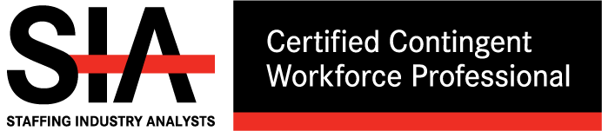
View the full schedule of classes at:
www.staffingindustry.com/certification
@SIACCWP #CCWP
Invest in Your Future. Today.
CCWP is fast becoming the industry’s most sought after accreditation. It unifies a common language, and draws a road map for your continuous improvement in contingent workforce programs.
Register Today!
Oct. 2-3 | Tampa, FL
Oct. 15-16 | New York, NY
Oct. 22-23 | London, UK
Nov. 6-7 | Seattle, WA

Slide 33

View the full schedule of classes at:
www.staffingindustry.com/certification
@SIACCWP #CCWP
Expand Your Expertise in SOW. Now.
SOW Management Expert Class will help you:
Control costs and enhance SOW
project/services quality
Establish and optimize SOW program
management capabilities
Elevate your knowledge and career
Register Today!
Nov. 22-23 | London, UK

Slide 34

Copies of the slides and a link to the audio recording will be distributed to all attendees within 48 hours following the webinar.
A replay of this webinar will be available for our CWS Council and Premium Corporate members at: www.staffingindustry.com/webinars-buyer
SIA | Staffing Industry Analysts Contingent Workforce Strategies Council Webinar

Slide 35





About Staffing Industry Analysts (SIA)
Founded in 1989, SIA is the global advisor on staffing and workforce solutions. Our proprietary research covers all categories of employed and non-employed work including temporary staffing, independent contracting and other types of contingent labor. SIA’s independent and objective analysis provides insights into the services and suppliers operating in the workforce solutions ecosystem including staffing firms, managed service providers, recruitment process outsourcers, payrolling/compliance firms and talent acquisition technology specialists such as vendor management systems, online staffing platforms, crowdsourcing and online work services. We also provide training and accreditation with our unique Certified Contingent Workforce Professional (CCWP) program.
Known for our award-winning content, data, support tools, publications, executive conferences and events, we help both suppliers
and buyers of workforce solutions make better-informed decisions that improve business results and minimize risk.
As a division of the international business media company, Crain Communications Inc., SIA is headquartered in Mountain View, California, with offices in London, England.
For more information: www.staffingindustry.com
For global coverage across the workforce solutions ecosystem, follow us and connect via
@SIAnalysts
PROPRIETARY DATA, DO NOT DISTRIBUTE OUTSIDE YOUR ORGANIZATION. Your company’s use of this report precludes distribution of its contents, in whole or in part, to other companies or individuals outside your organization
in any form – electronic, written or verbal – without the express written permission of Staffing Industry Analysts. It is your organization’s responsibility to maintain and protect the confidentiality of this report.
Staffing Industry Analysts | 1975 W. El Camino Real, Ste. 304 | Mountain View, CA 94040 | 800.950.9496 | www.staffingindustry.com
SIA | Staffing Industry Analysts Contingent Workforce Strategies Council Webinar

